Slide 1

9 Dogs Breeds Identification & Classification
Vinolia varsha s

Slide 2
Dataset
Dataset name : 9Breeds Data
Dataset link: https://www.kaggle.com/datasets/muhammadhananasghar/9-dogs-breeds-identification-classification

Slide 3
Problem statement
Balancing the data is more important. Imbalanced data is not always a bad thing, and in real data sets, there is always some degree of imbalance. That said, there should not be any big impact on your model performance if the level of imbalance is relatively low.
In this model we are going to see the analysis of Balanced vs Imbalanced data and the F1 scores by creating a model of the different breeds of dogs and instantiate the custom callback and train the model.
This model also contains custom callback, It is a combination of the Keras callbacks Reduce Learning Rate on Plateau, Early Stopping and Model Checkpoint but eliminates some of the limitations of each. In addition it provides an easier to read summary of the model's performance at the end of each epoch.

Slide 4

Balanced dataset
Balanced Dataset: Let’s take a simple example if in our data set we have positive values which are approximately same as negative values. Then we can say our dataset in balance
Balance Dataset
Consider Orange color as a positive values and Blue color as a Negative value. We can say that the number of positive values and negative values in approximately same.

Slide 5
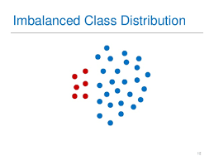
Imbalanced Dataset
Imbalanced Dataset: If there is the very high different between the positive values and negative values. Then we can say our dataset in Imbalance Dataset.

Slide 6
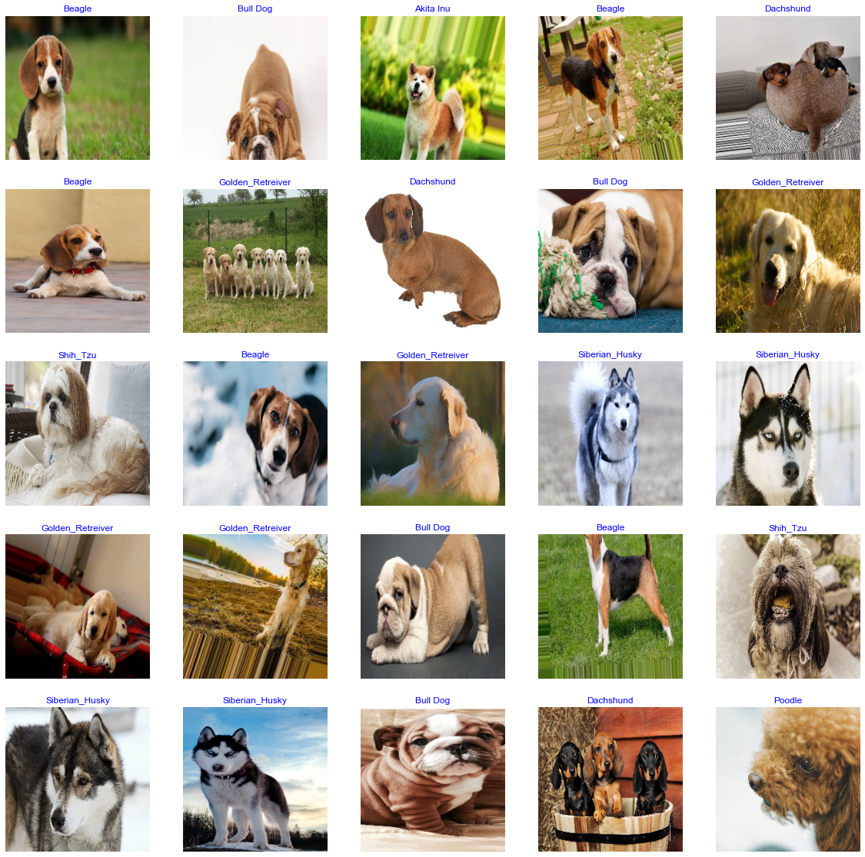
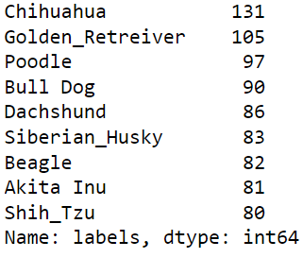
9 Dogs Breeds

Slide 7
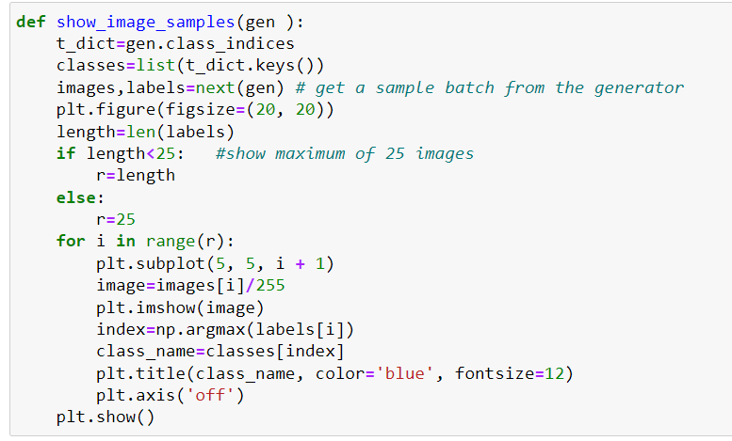
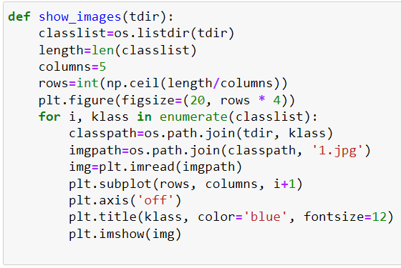
Define a function to show example training images

Slide 8
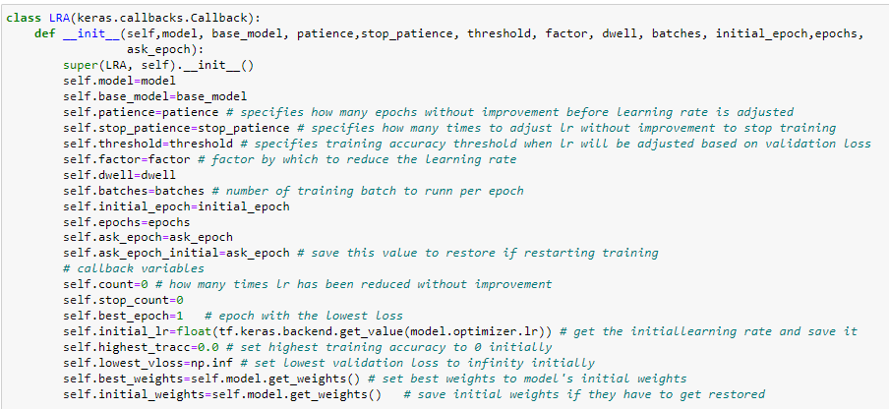
Define Keras Callbacks
Defining a subclass of Keras callbacks that will control the learning rate and print training data in spreadsheet format.
The callback also includes a feature to periodically ask if you want to train for N more epochs or halt

Slide 9
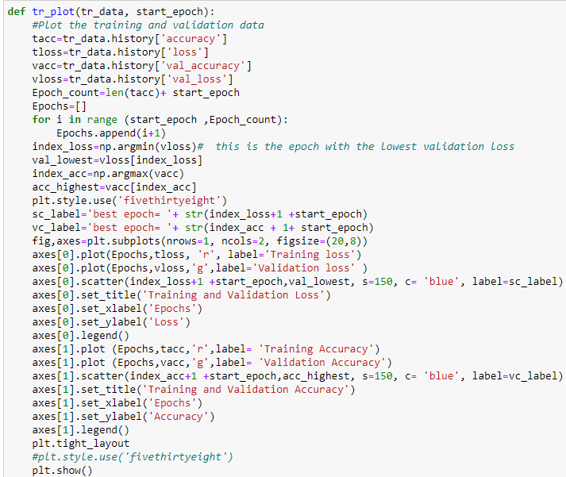
Define a function to plot the training data
Plotting the training and the validation data
Defining a function for the lowest validation loss and highest accuracy

Slide 10
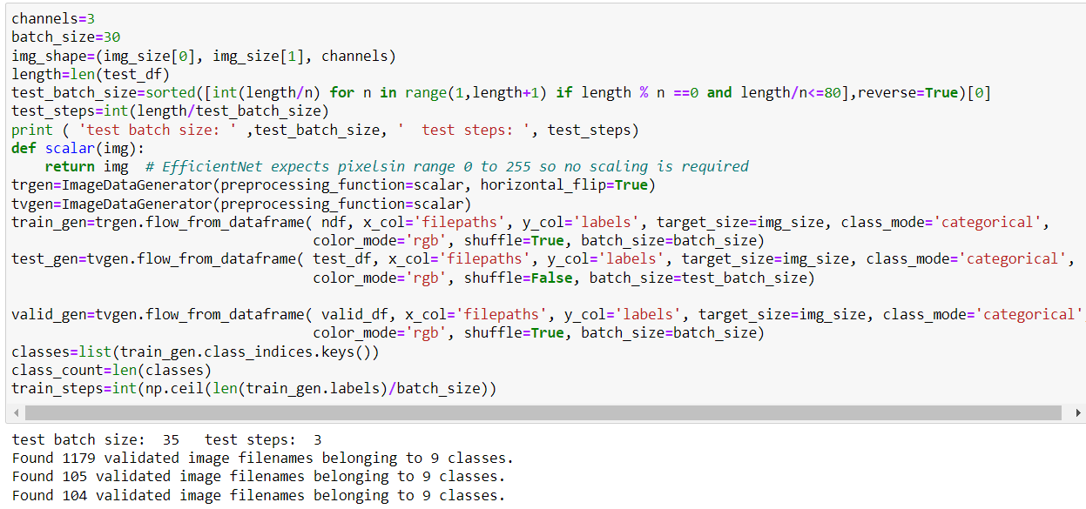
Creating train, test and validation generators

Slide 11
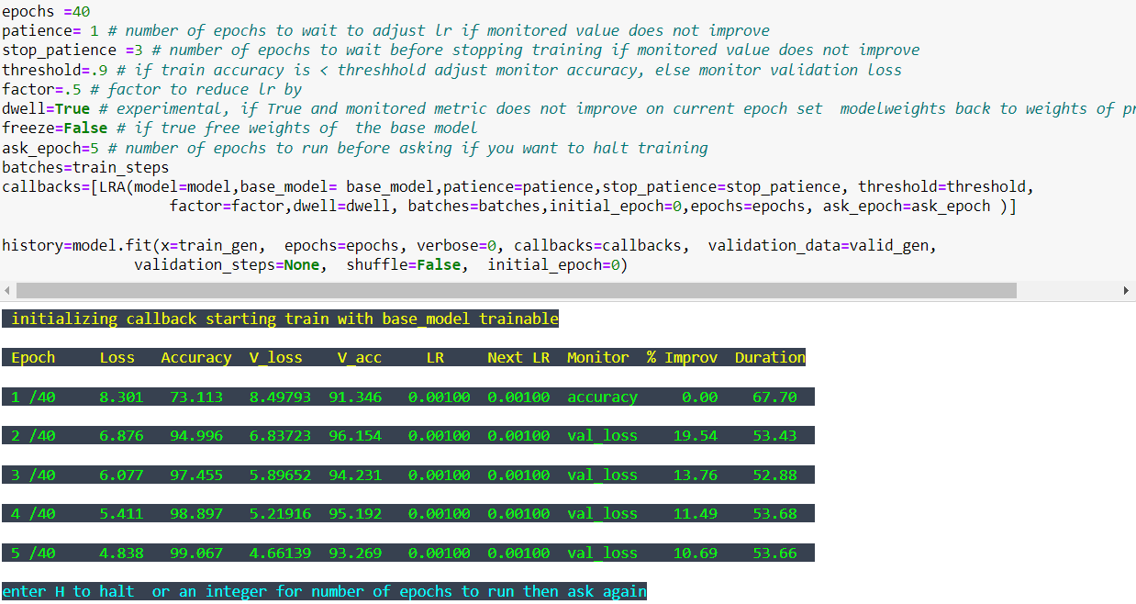
instantiate the custom callback and train the model

Slide 12
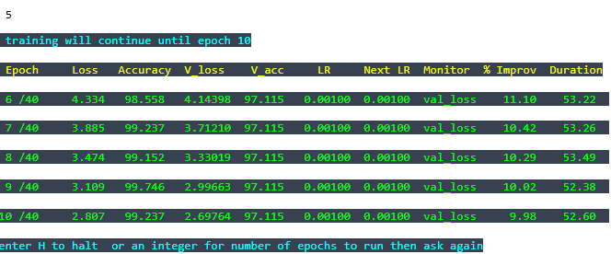
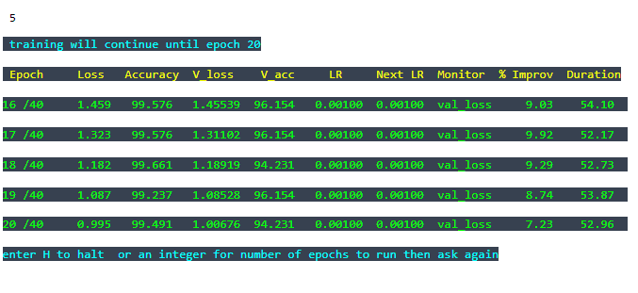
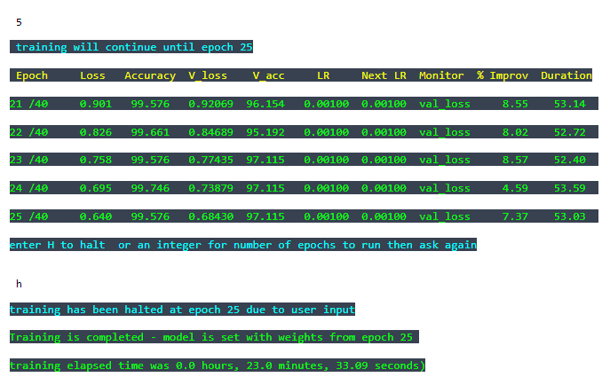
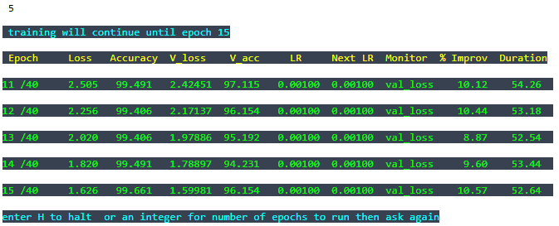
instantiate the custom callback and train the model

Slide 13
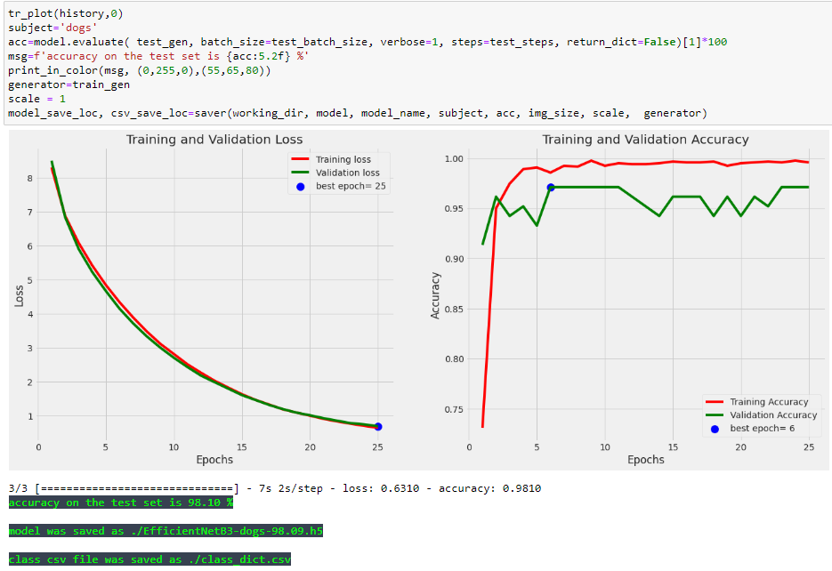
evaluate model on the test set then save the model

Slide 14
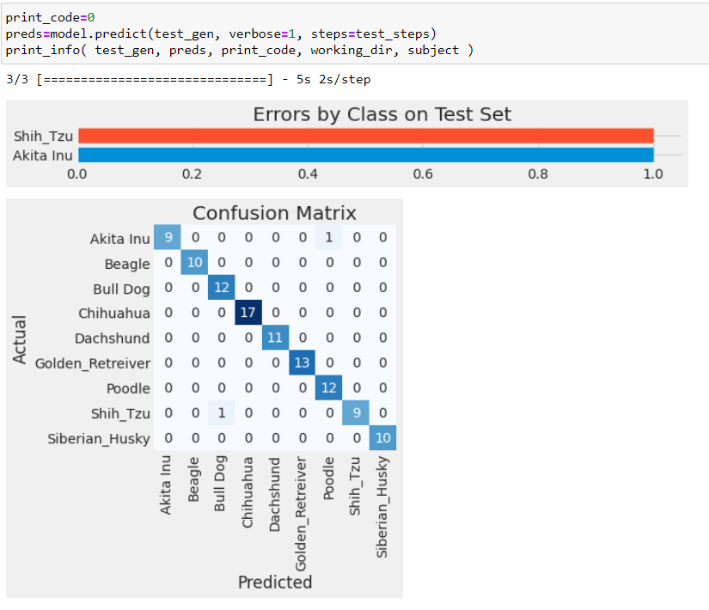
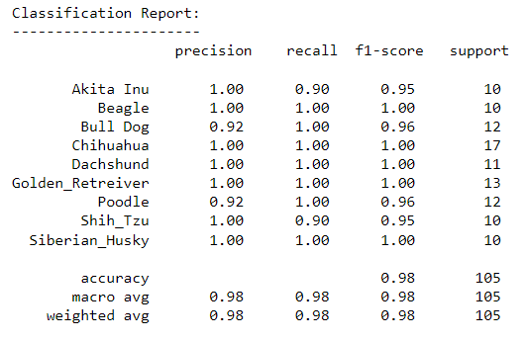
Predictions on test set and generate confusion matrix and classification report

Slide 15
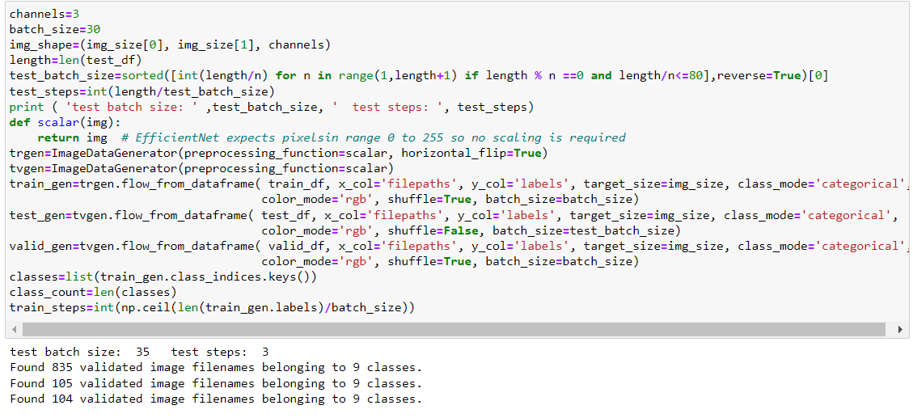
F1 score is without balancing the dataset
Recreate the generators

Slide 16
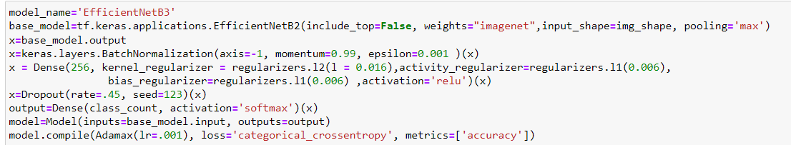
Recreating the model

Slide 17
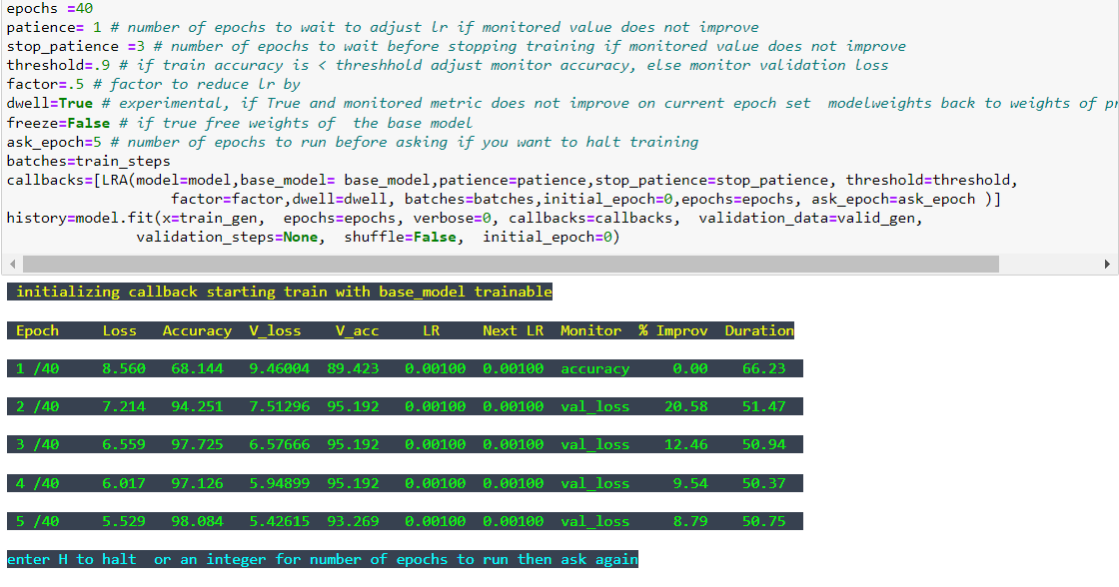
Retrain the model on unbalanced datase

Slide 18
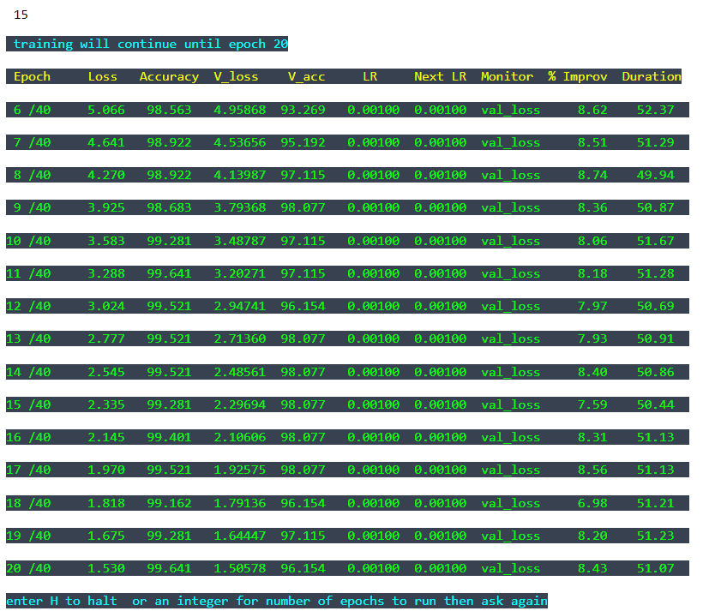
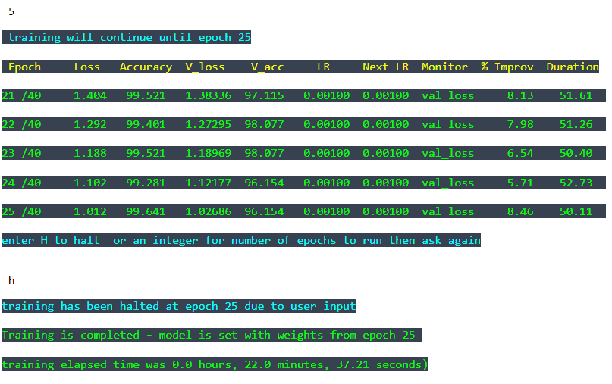
Retraining the model on unbalanced dataset

Slide 19
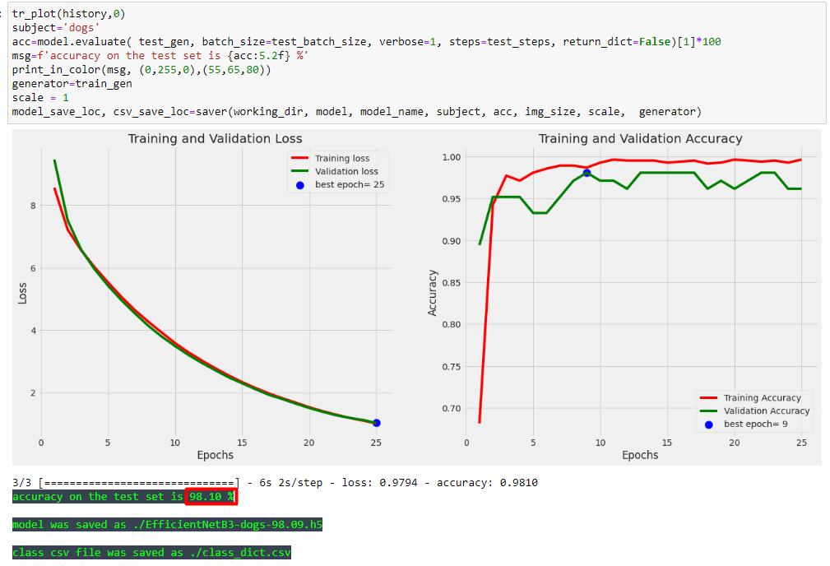
Plotting results and get accuracy on test set

Slide 20
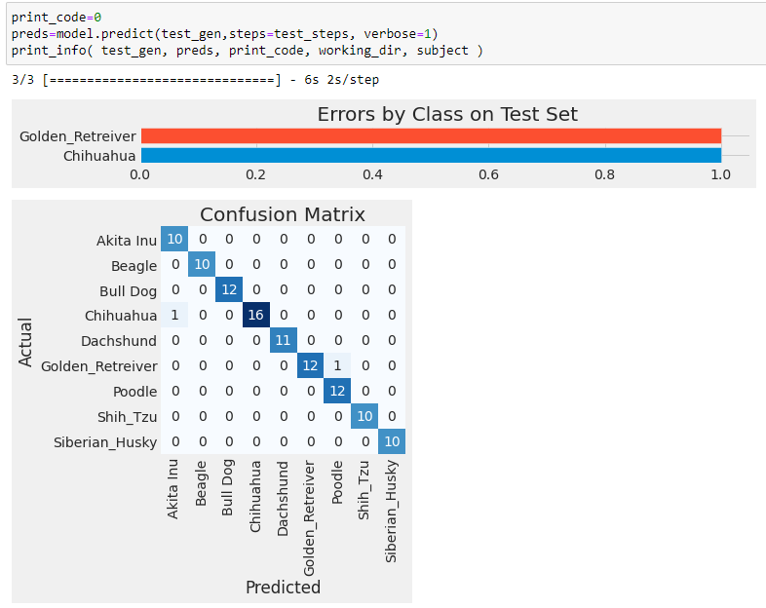
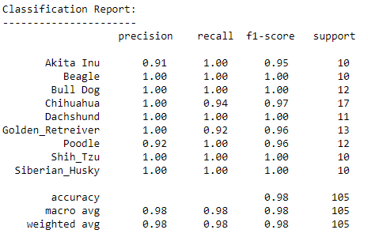
Confusion Matrix and F1 score for unbalanced dataset

Slide 21
Conclusion
The epoch run up to 25 both on balanced and unbalanced data
There is not much different between the balanced and unbalanced data
Both the accuracy is 98%
The f1 score in both the case are same

Slide 22

THANK YOU
FOR
REVIEWING
MY WORK

